Slide 1


TRAIN TICKET RESERVATION SYSTEM
TORRY HARRIES INTEGRATION SOLUTIONS

Slide 2


OUR TEAM MEMBERS
MUGDHA SRIVASTAVA (6150)
SHIVA RAM GILLEPALLY (6152)
HARIPRIYA KUMAR (6156)
BALAMURUGAN (6161)
SAIVANI VORADI (6164)

Slide 3
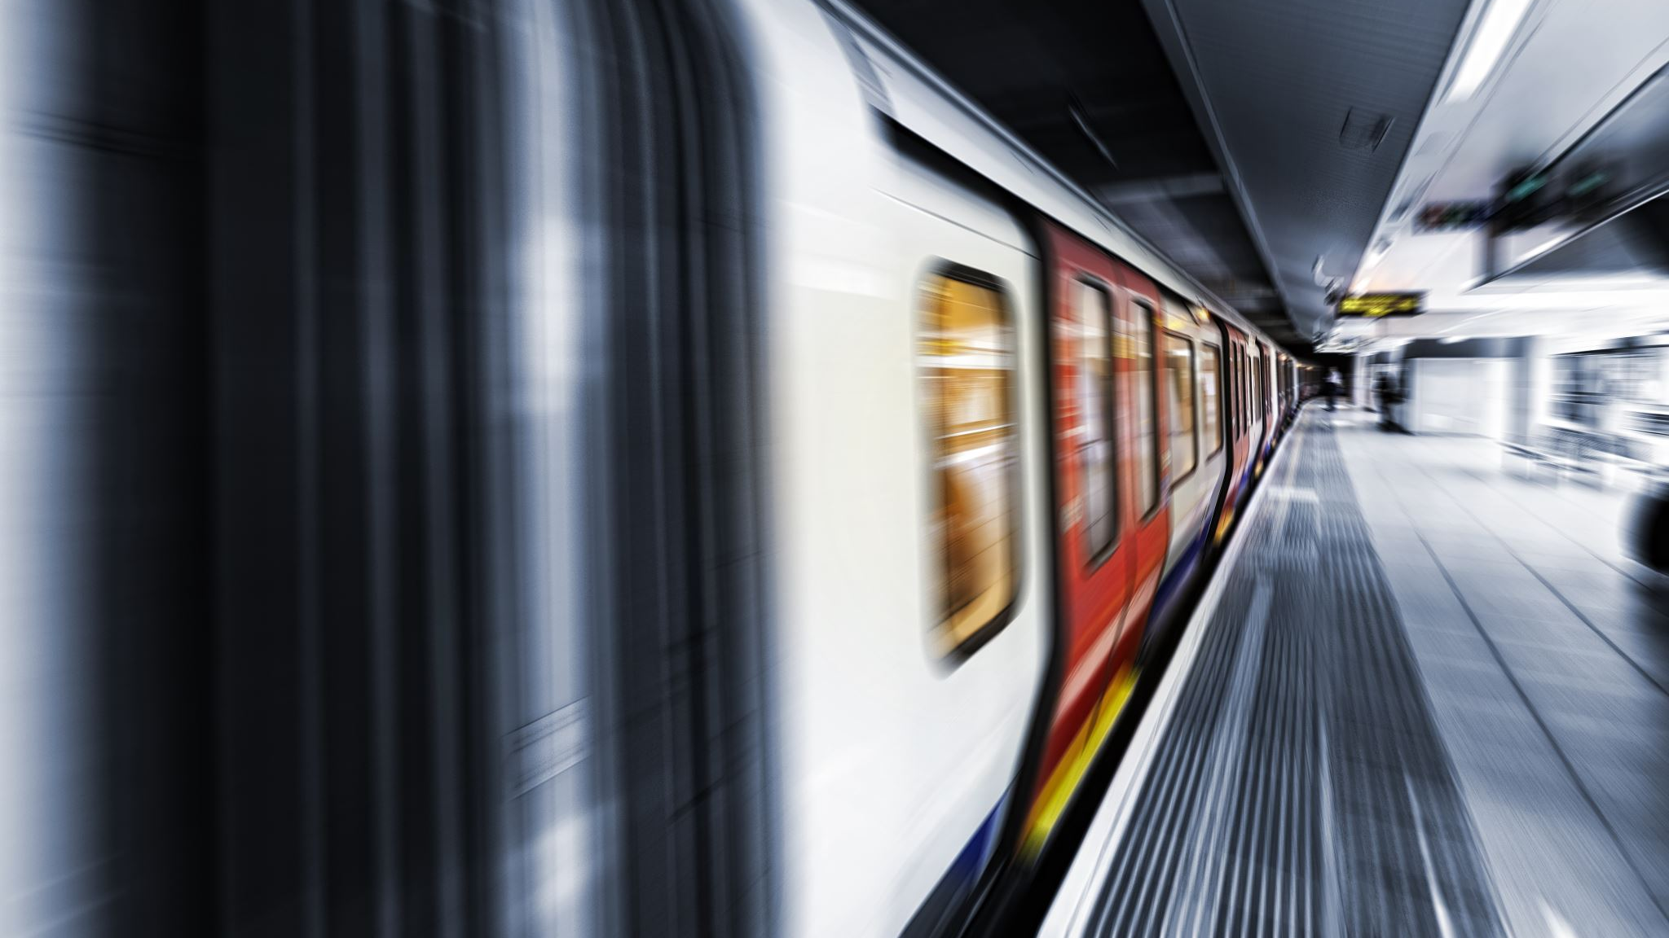
Problem statement:
Built a train ticket booking system that allows customers to book train tickets online , payment should done through online, search the status of the ticket , print the ticket and a feedback from the passengers.

Slide 4



Technology used:
HTML/CSS(visual studio)
JavaScript
Bootstrap
Spring (Spring Tool Suite)
MySQL(Heidi SQL)

Slide 5
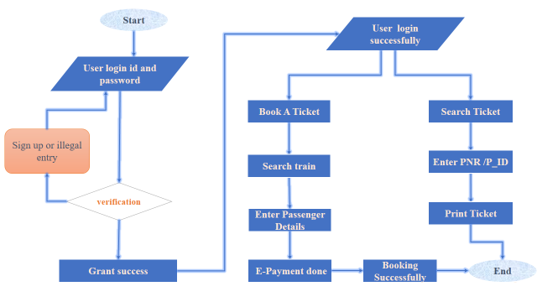
FLOW CHART

Slide 6

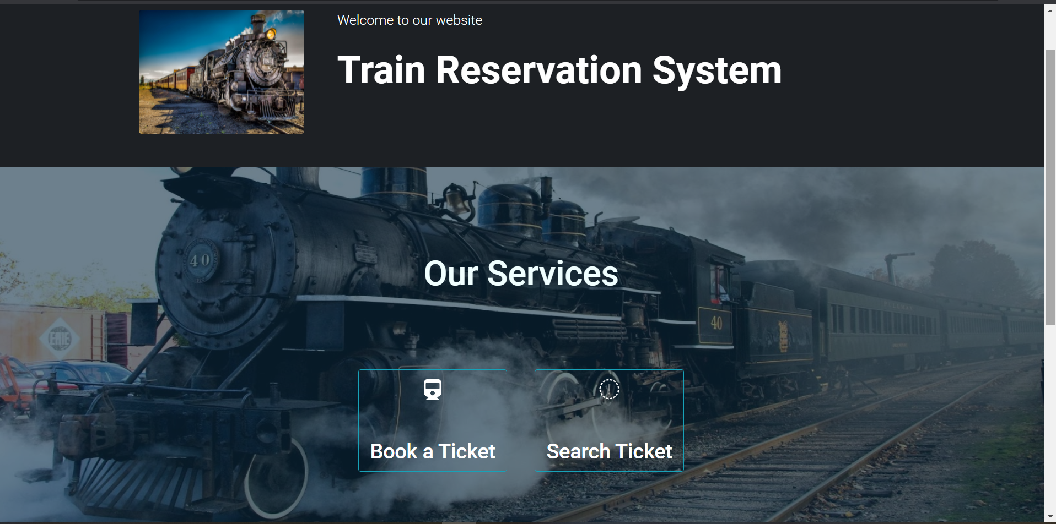
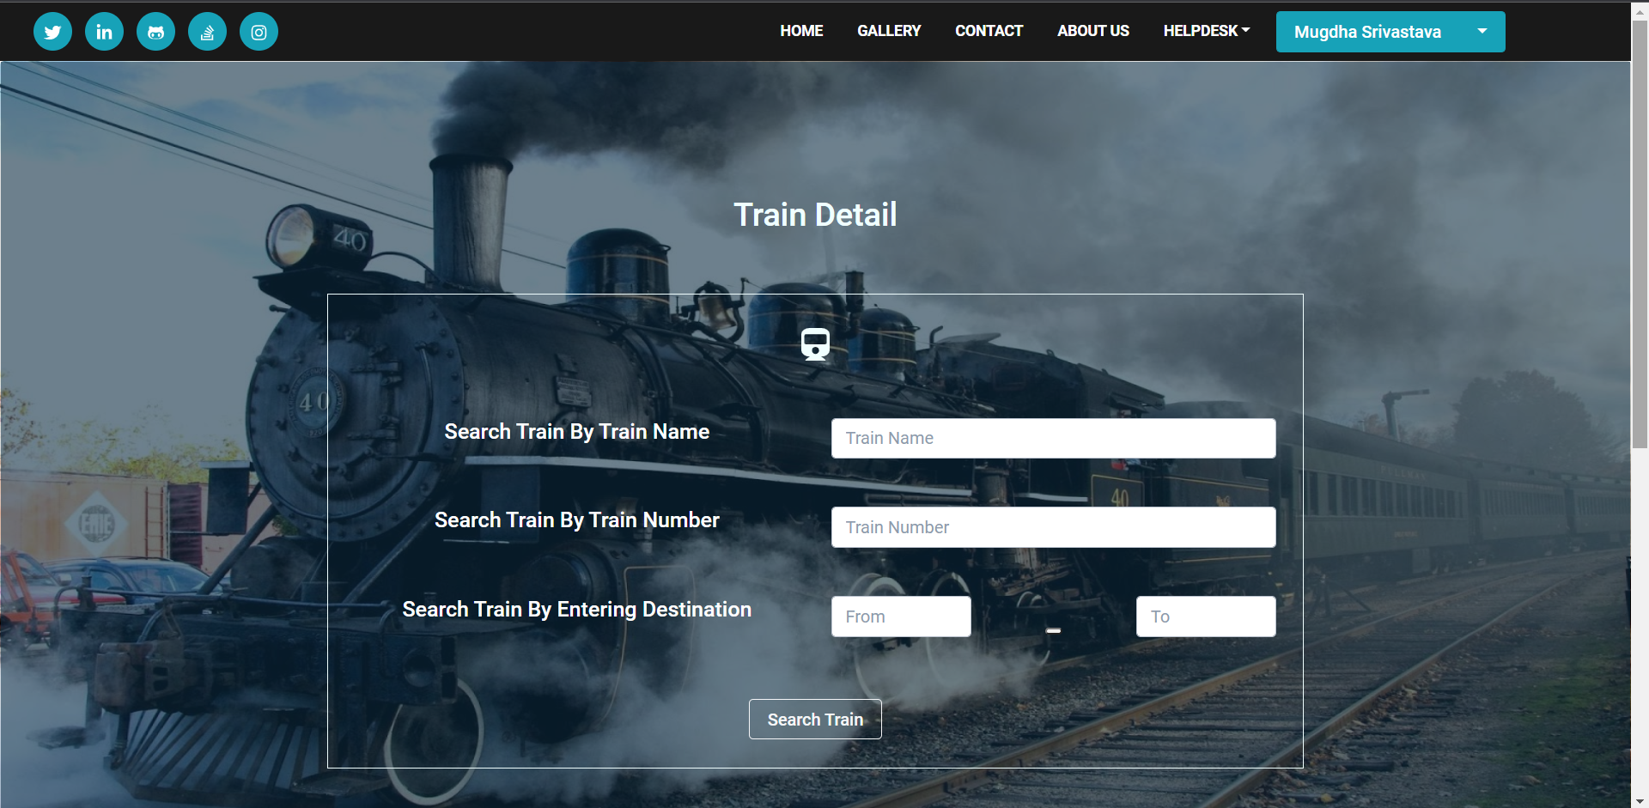
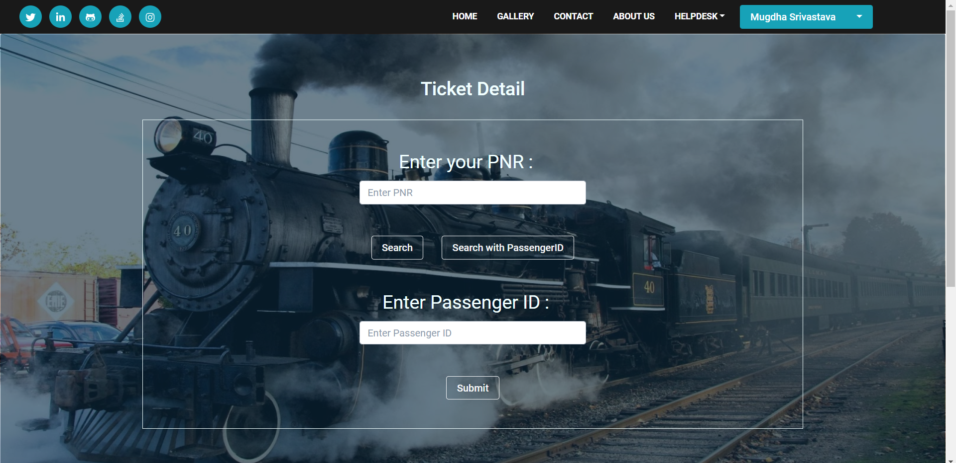
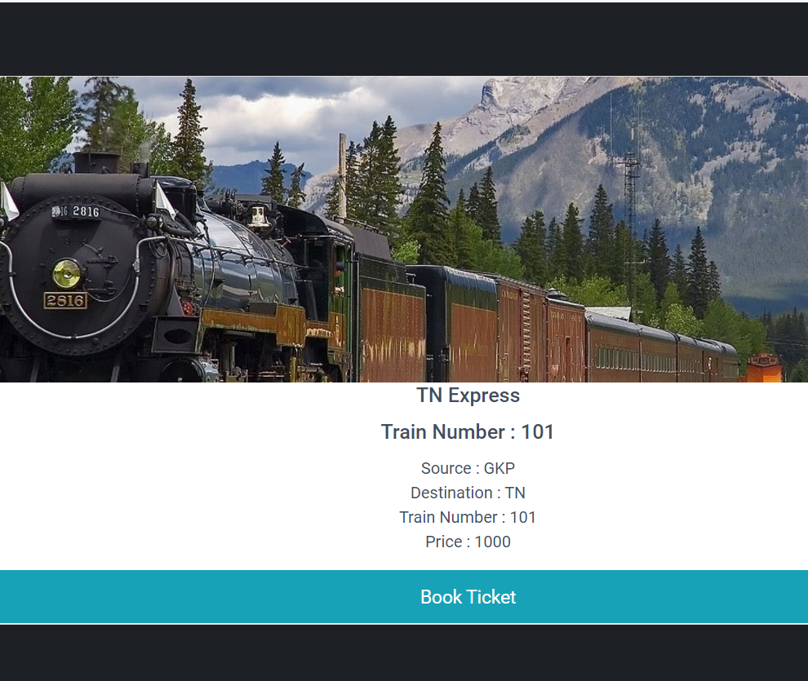
Frames of our project -

Slide 7
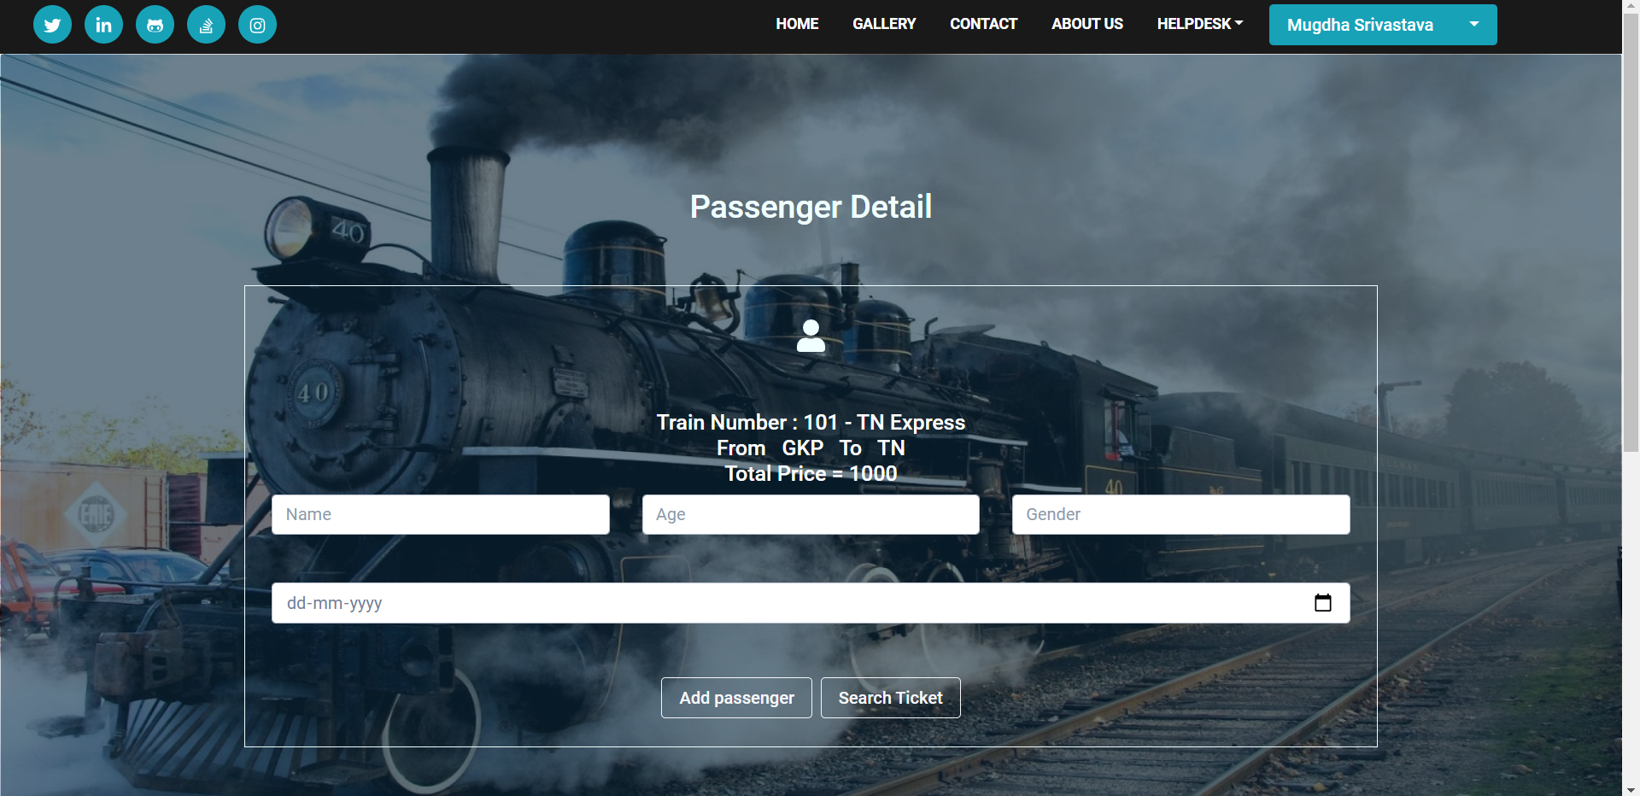
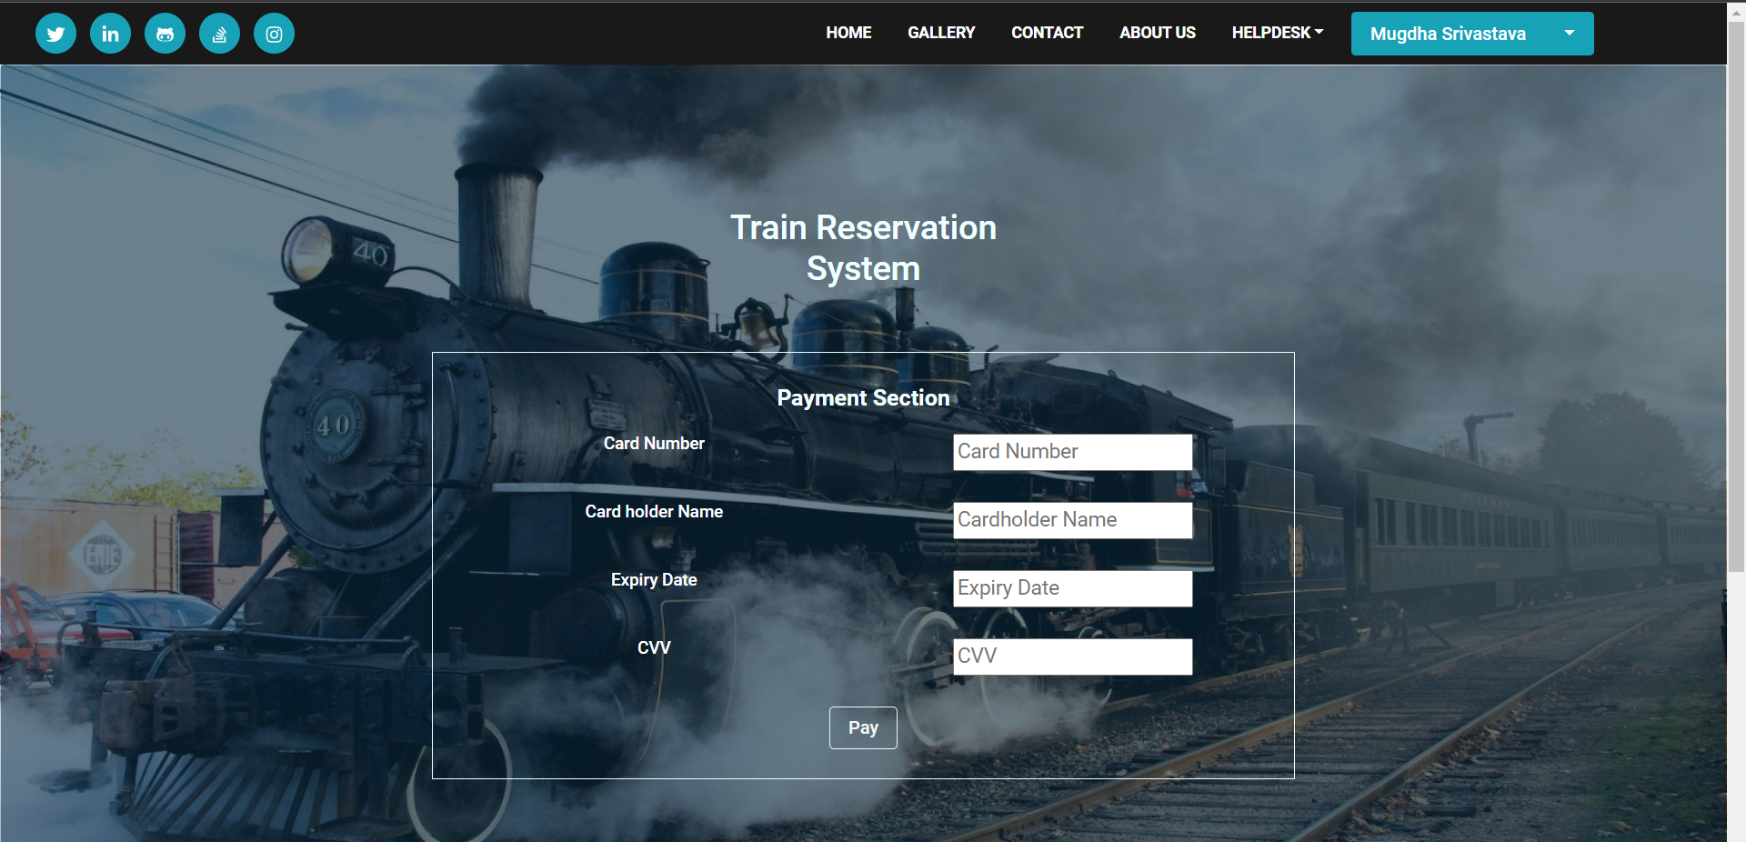
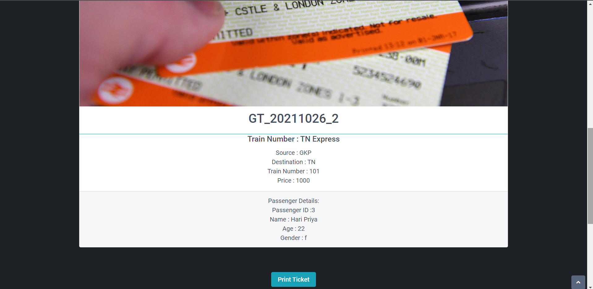
Frames of our project -

Slide 8
SUMMERY
User login page passenger can log in through their username
If the user is new then user is navigated to sign up page
User can book ticket using train name or train id
While booking ticket we have online payment
After booking a ticket user can check his ticket status using search ticket
Feedback form is provided after travelling user can give his/her experience in travelling

Slide 9
FUTURE ENHANCEMENT
Last Transaction Details will be shown in one click.
Website to make predictive entry suggestions and auto suggest names of passengers and details based on previous bookings.
We can add voice recognition and AI chat bot features.
PNR Enquiry, Confirmation Status, Refund status check and train tracking facility will be provided.
cancellation of ticket in one click.

Slide 10
Thank you

